Slide 1
Newton-type Methods
Ayşen YILDIZ Esra Nur ÇAKICI H.Yavuz ERZURUMLU

Slide 2
What is Newton-type Method?
One of the most famous numerical methods.
An approach for solving nonlinear equations.
An optimization method.
Application areas:
Relevance in machine learning, signal and image processing, computer networks, computer vision, and high dimensional statistics can be used.

Slide 3
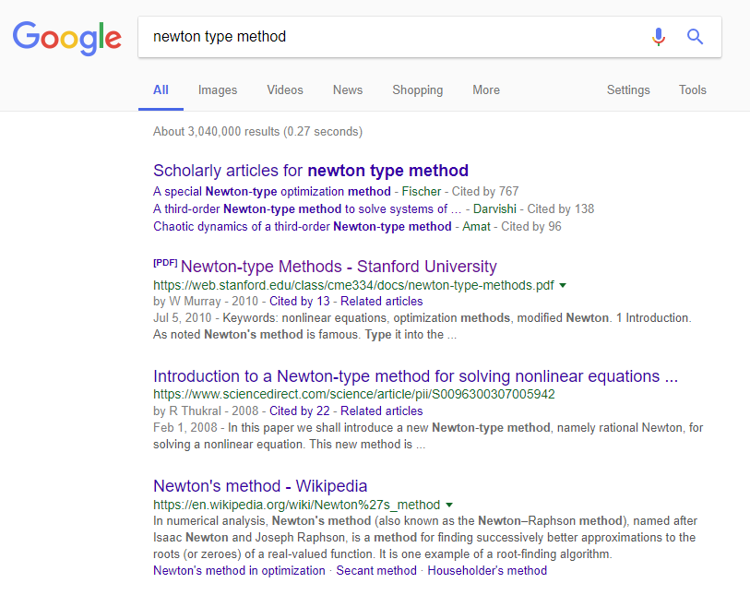
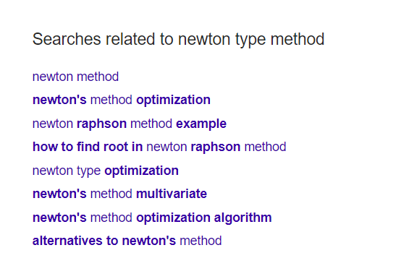
What is Newton-type Method?

Slide 4
Several Topics
• Estimating root of f(x) function: Newton Raphson Method
• One Dimensional Unconstrained Optimization
• Multi Dimensional Unconstrained Optimization

Slide 5
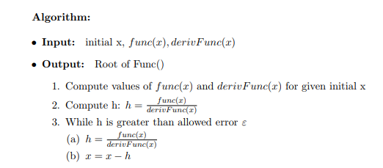
Newton Raphson Method - Algorithm

Slide 6
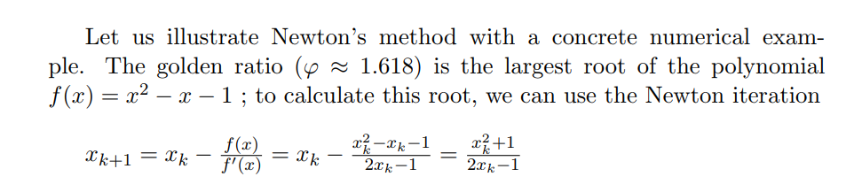
An Example

Slide 7
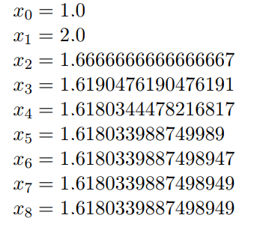
An Example

Slide 8
Complexity:
O((logn)F(n))
where F(n) is the cost of calculating f(x)/f’(x) with n-digit precision.

Slide 9
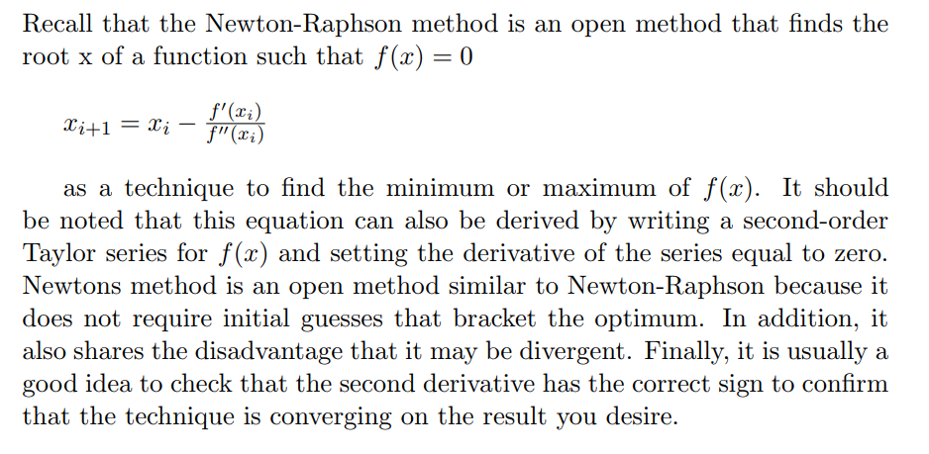
One Dimensional Unconstrained Optimization

Slide 10
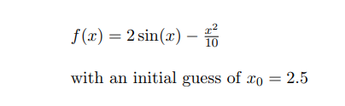
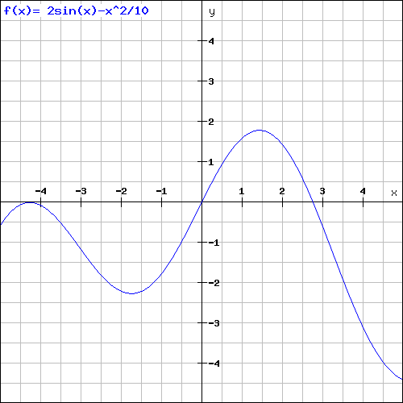
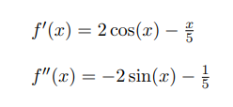
An Example

Slide 11
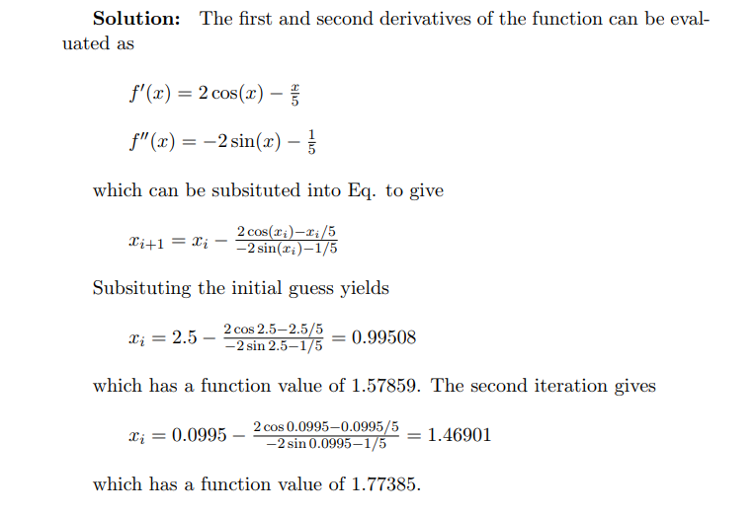
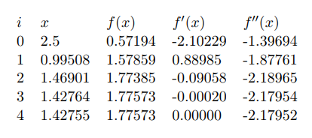
An Example

Slide 12
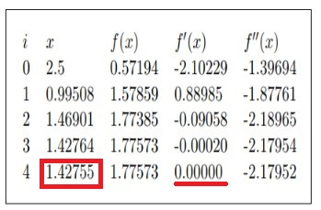
f ’(x0)=0, f ’’(x0)>0 than x0 is minimum of function.
f ’(x0)=0, f ’’(x0)<0 than x0 is maximum of function.
f ’(x0)=0, f ’’(x0)<0 than x0 is try other methods.

Slide 13
Complexity :
Complexity is related with the initial value. It is O(lg(n)) which n is initial value.

Slide 14
Multidimensional Unconstrained Optimization
Extend the Newton’s method for 1-D case to multidimensional case. Given f(X), approximate f(X) by a second order Taylor series at X = Xi : where (X is vector)

Slide 15
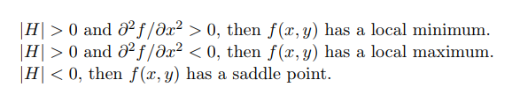
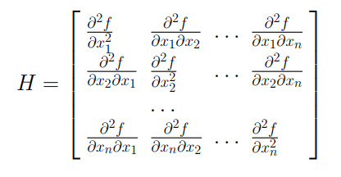
Multidimensional Unconstrained Optimization
where H is the Hessian matrix:

Slide 16
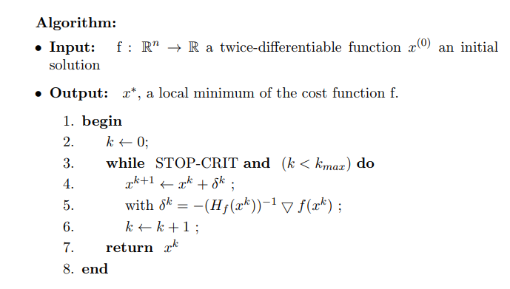
Multidimensional Unconstrained Optimization
Stop-Criteria : Difference between two vectors x^{k+1} - x^{k} < epsilon - very close to zero.

Slide 17
Pitfalls and Improvings
We must calculate inverse of H for every iteration.
It requires both first and second partial derivatives, which may not be practical to obtain .
Using a step size of unity, the method may not converge.
We can use Quasi - Newton Method for to avoid calculating inverse of H.

Slide 18
Quasi - Newton Method
Quasi-Newton, or variable metric, methods seek to estimate the direct path to the optimum in a manner similar to Newton’s method. However, notice that the Hessian matrix is composed of the second derivatives of f that vary from step to step. Quasi-Newton methods attempt to avoid these difficulties by approximating H with another matrix A using only first partial derivatives of f. The approach involves starting with an initial approximation of H−1 and updating and improving it with each iteration. The methods are called quasi-Newton because we do not use the true Hessian, rather an approximation. Further readings : DFP,BFGS
DFP -> Davidon-Fletcher-Powell BFGS -> Broyden-Fletcher-Goldfarb-Shanno

Slide 19
Comparison Newton’s Method to Quasi- Newton
Newton’s Method | Quasi-Newton Method
Computationally expensive | Computationally cheap
Slow computation | Fast(er) computation
Need to iteratively calculate second derivative | No need for second derivative
Need to iteratively solve linear system of equations | No need to solve linear system of equations
Less convergence steps | More convergence steps
More precise convergence path | Less precise convergence path

Slide 20
Conclusions
We deal with newton type methods algorithms, its advantages and pitfalls.
We proposed to use this approach if we can calculate derivatives easily.
If we have second derivatives we can compute local minimum or maximum of given function. (1-D,2-D) The disadvantages of using this method are numerous. First of all, it is not guaranteed that Newton’s method will converge if we select an initial root which that is too far from the exact root. Likewise, if our tangent line becomes parallel or almost parallel to the x-axis, we are not guaranteed convergence with the use of this method. Another disadvantage is that we must have a functional representation of the derivative of our function, which is not always possible if we working only from given data.

Slide 21
Questions?

Slide 22
Thanks :)

